Slide 1

Sensor Kit (Kit 1)
ZAS Robotics Training

Slide 2



Sensor Kit - Contents
Sensor Kit Components
Sensor Creative Board

Slide 3



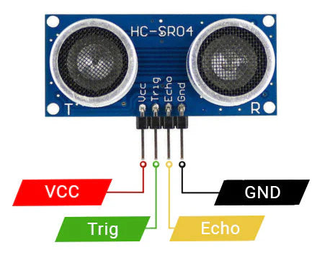

SFL13: ULTRASONIC SENSOR WITH OLED
Things Needed

Slide 4
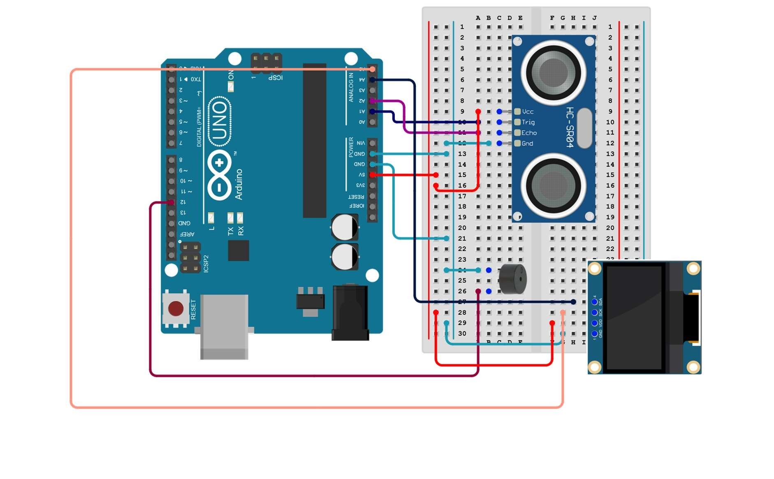
SFL13: ULTRASONIC SENSOR WITH OLED
Connections:
Arduino pins | Breadboard
5V | VCC(red)
GND | GND(light blue)
A1 | TRIG
A2 | ECHO

Slide 5
SFL13: ULTRASONIC SENSOR WITH OLED
Install libraries OLED
Setup
connecting to respective pins
A1-trig
A2-echo
ground and VCC connections
Loop
measurement of distance to be displayed on OLED according to obstruct placement.
Code for lesson 13:
https://github.com/info-zas/zas-robotics-sensors/blob/main/01_FoundationProjects/01_Code/_14_DistanceMeasurementUsingUltrasonicSensor/_14_DistanceMeasurementUsingUltrasonicSensor.ino

Slide 6
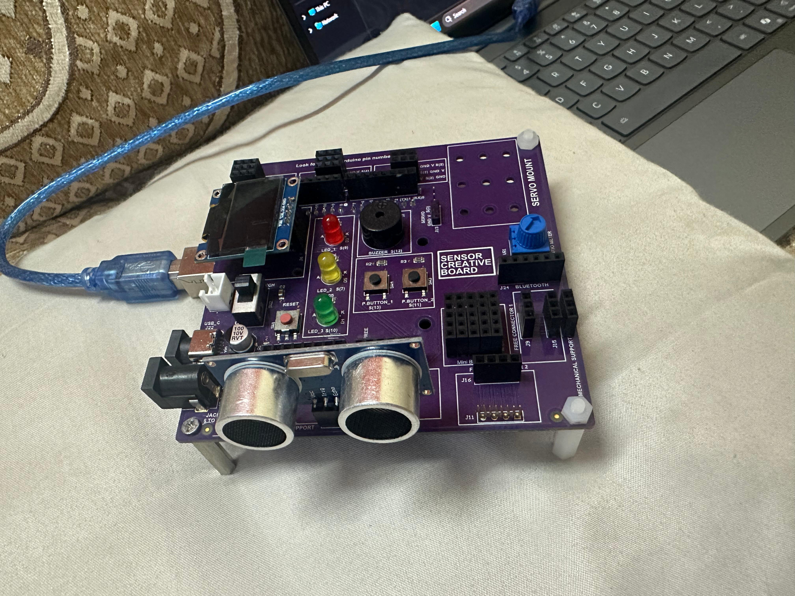
SFL13: ULTRASONIC SENSOR WITH OLED

